Slide 1


Dijkstra Algorithm
FARES WAEL

Slide 2
Overview of Shortest Path Problem
E
6
1
Definition
B
1
The shortest path problem involves finding the shortest path between two nodes in a graph.
1
4
D
A
2
Weighted Graphs
2
1
3
In this problem, the graph is often weighted, meaning that each edge has a numerical weight associated with it.
C
3
Optimization Goal
The goal is to minimize the total weight of the path

Slide 3
Pseudo code of Dijkstra's Algorithm
ALGORITHM Dijkstra(G, s)
//Dijkstra’s algorithm for single-source shortest paths
//Input: A weighted connected graph G = (V,E) with nonnegative weights
// and its vertex s
//Output: The length dv of a shortest path from s to v
// and its penultimate vertex pv for every vertex v in V
Initialize(Q) //initialize priority queue to empty
for every vertex v in V
dv ← ∞; pv ← null
Insert(Q, v, dv) //initialize vertex priority in the priority queue
ds ← 0; Decrease(Q, s, ds) //update priority of s with ds
VT ← ∅
for i ← 0 to |V | − 1 do
u∗ ← DeleteMin(Q) //delete the minimum priority element
VT ← VT ∪ {u∗}
for every vertex u in V − VT that is adjacent to u∗ do
if du∗ + w(u∗, u) < du
du ← du∗ + w(u∗, u); pu ← u∗
Decrease(Q, u, du)

Slide 4
v
Visualization
7
5
∞
Queue:(C , Cost:3)
(D , Cost:5)
(E , Cost:7)
E
Queue:
E
Queue:(D , Cost:4)
(D , Cost:5)
(E , Cost:7)
Queue:(D , Cost:5)
(E , Cost:5)
(E , Cost:7)
Queue:(E , Cost:7)
Queue:(B , Cost:1)
(C , Cost:3)
Queue:(A , Cost:0)
Queue:(E , Cost:5)
(E , Cost:7)
∞
1
B
B
D
D
∞
4
5
A
A
C
C
3
∞

Slide 5
Implementation
from queue import PriorityQueue
def dijkstra(graph, start):
shortest_paths = {start: (None, 0)}
queue = PriorityQueue()
queue.put((0, start))
for _ in range(len(graph)):
(dist, current_node) = queue.get()
for neighbor, neighbor_dist in graph[current_node].items():
old_cost = shortest_paths.get(neighbor, (None, float('inf')))[1]
new_cost = dist + neighbor_dist
if new_cost < old_cost:
shortest_paths[neighbor] = (current_node, new_cost)
queue.put((new_cost, neighbor))
return shortest_paths

Slide 6

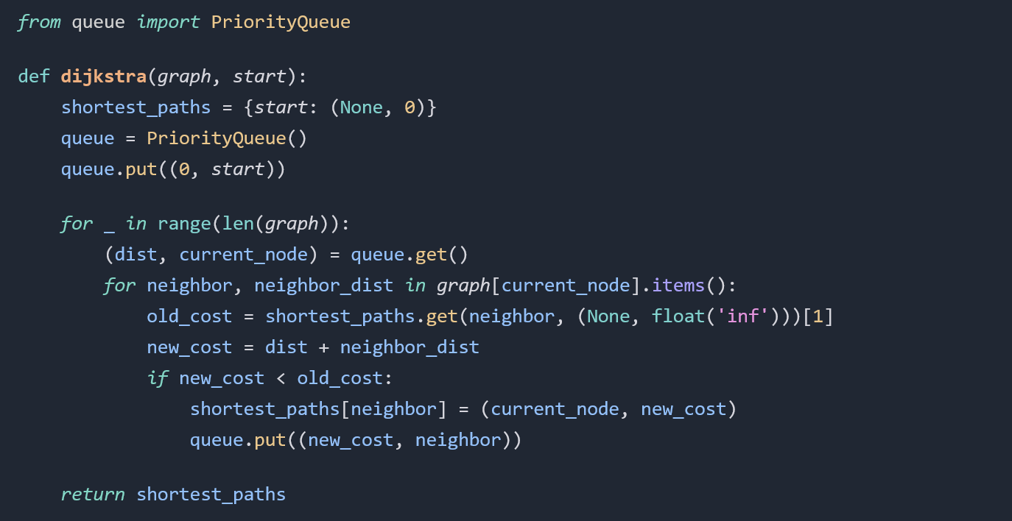
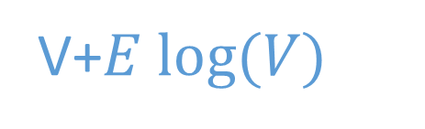
Time Complexity Analysis
V
E
V+$E log⁡(V)$

Slide 7
Applications of Dijkstra's Algorithm
1
Routing in Networks
Dijkstra's algorithm is commonly used in network routing protocols to find the shortest path between nodes.
Transportation Planning
2
It can be applied to model transportation networks and optimize routes for various modes of transport.
3
Robot Path Planning
Dijkstra's algorithm is utilized in robot path planning to calculate the most efficient path given obstacles and constraints.
Resource Allocation
4
It aids in optimizing the allocation of resources in various industries, such as supply chain management and logistics.

